Slide 1
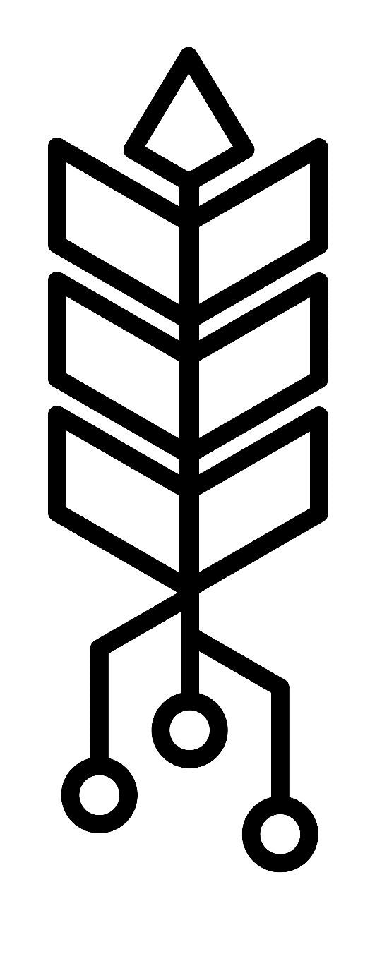
Cereal Grain Data Acquisition Device
Team Members: Ryan Donahue & Kennedy Caisley
Advisor & Client: Dr. Daniel Robertson

Slide 2
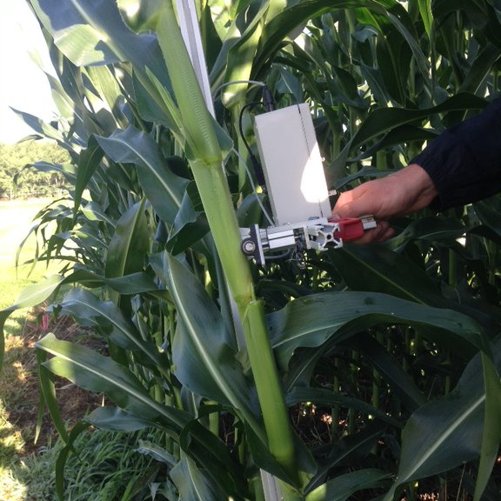
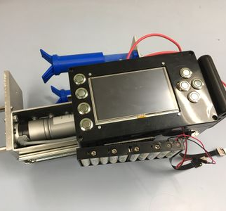
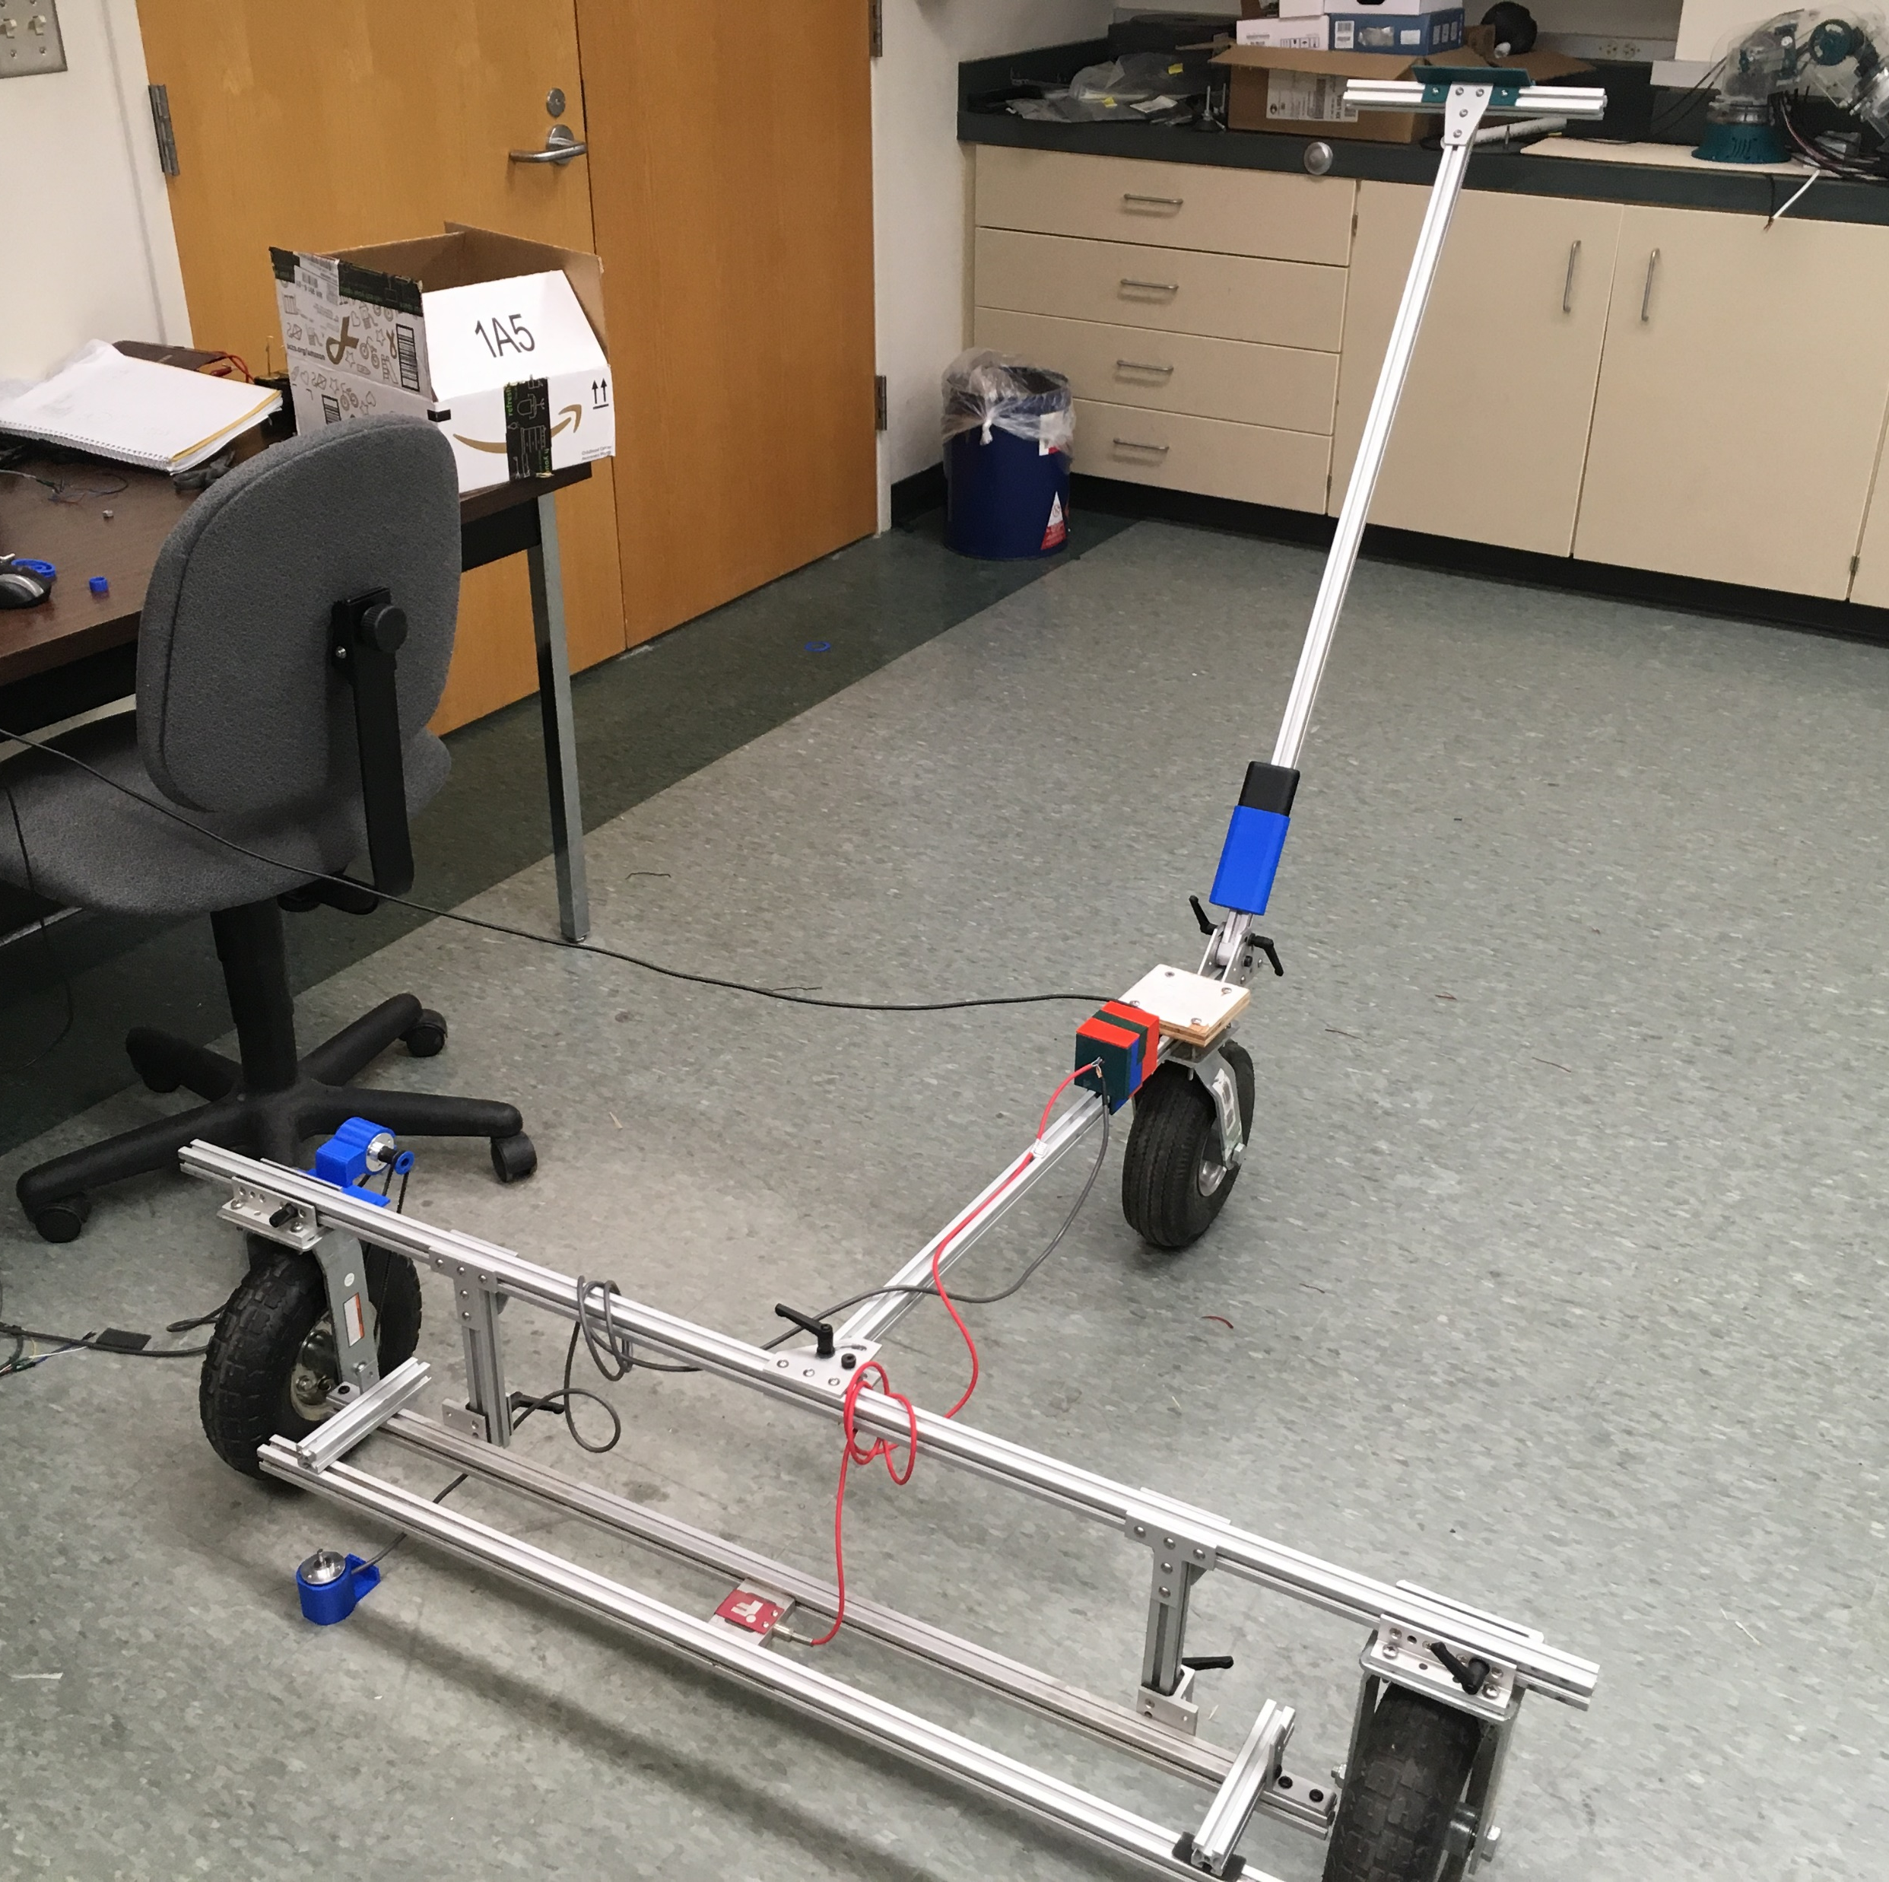
Target Platforms

Slide 3
Current Data Acquisition Devices
Expensive (>$600 per unit)
Difficult Assembly (20+ hours)
Unreliable
Mechanical button failures
Messy wires
No protection features
Not User Friendly
Poor navigation/user input
Poor performing hardware/software
INSERT IMAGES OF OLD DEVICES

Slide 4
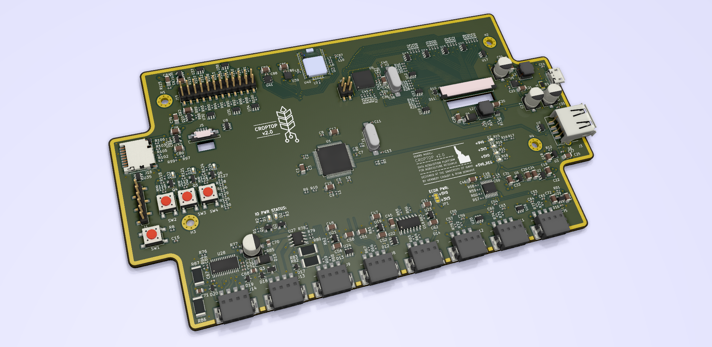
CropTop v2.0

Slide 5
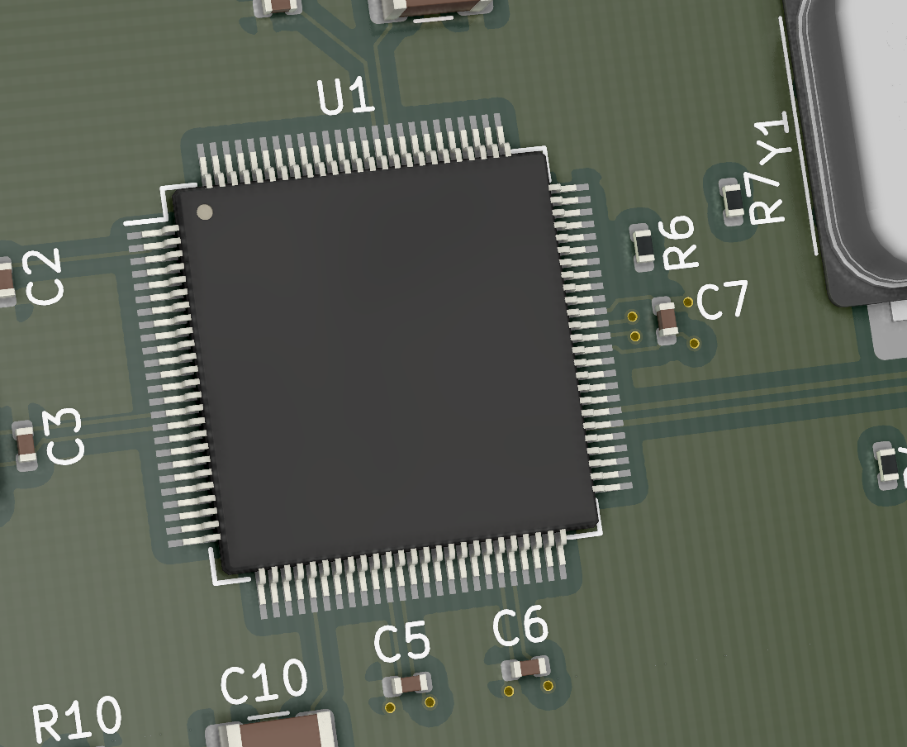
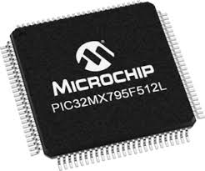
Microcontroller
Microchip PIC32MX795F512L
80MHz, 32-bit
USB, SPI, I2C, ADCs, PWM
Low-Cost
Familiar

Slide 6
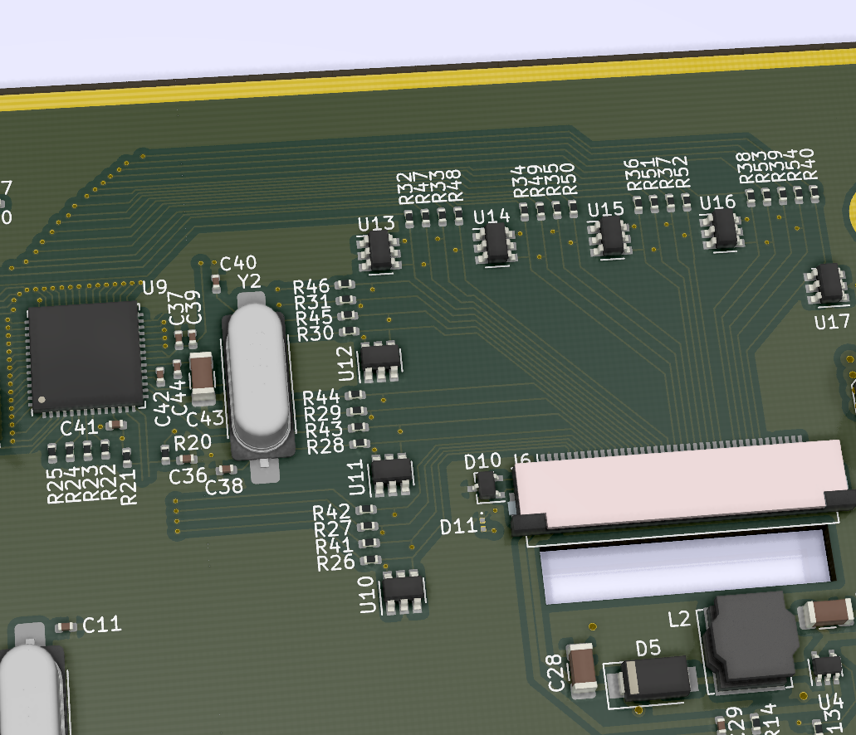
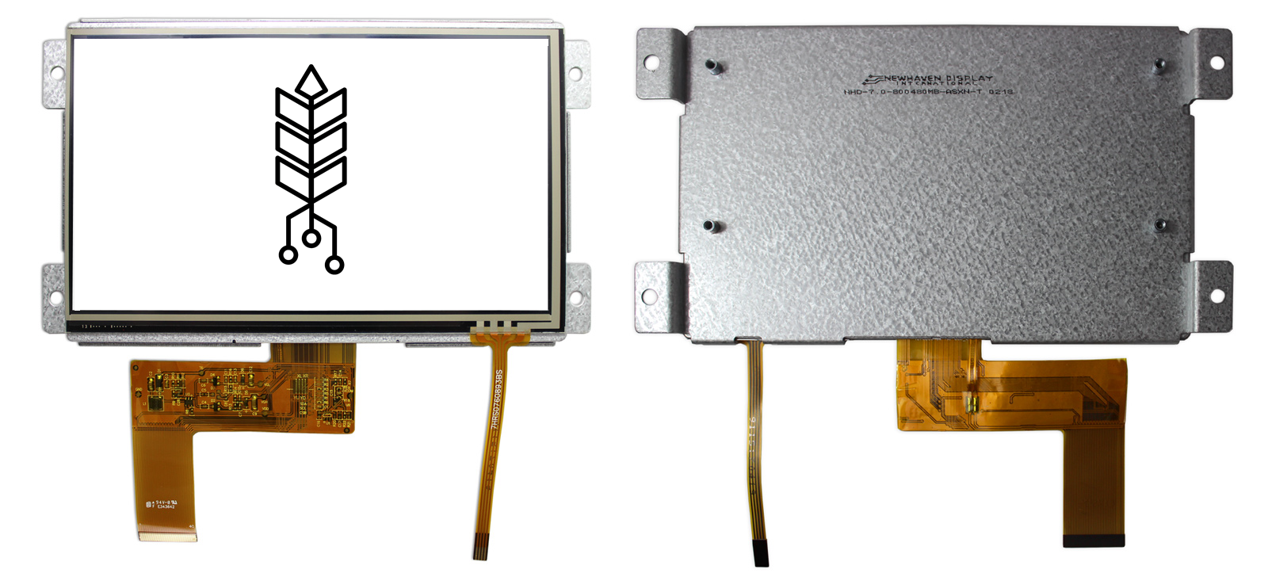
User Interface
7” 800x600 TFT LCD
Resistive Touch Panel
FTDI FT812 Graphics Coprocessor
SPI Interface with PIC32 MCU
Slotted PCB
+
Ft812

Slide 7
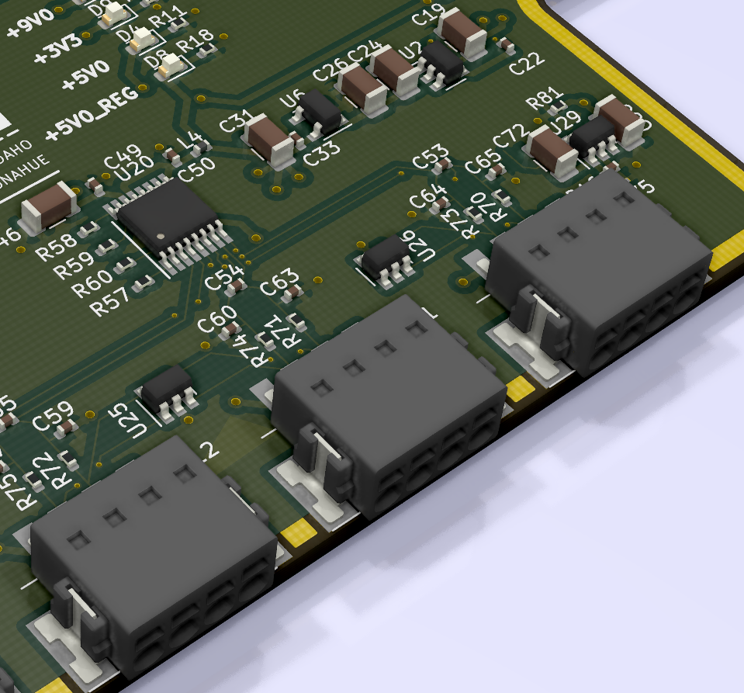
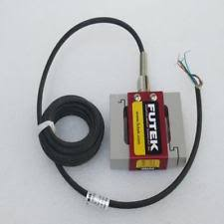
Load Cell Interface
Analog Devices AD7799
24-bit ΔΣ ADC
470Hz Sampling Rate
Supports up to 3 load cells
SPI Interface with MCU
Low-noise design
x3

Slide 8
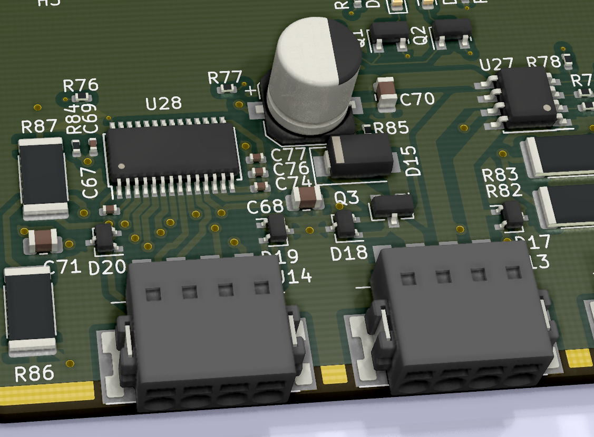
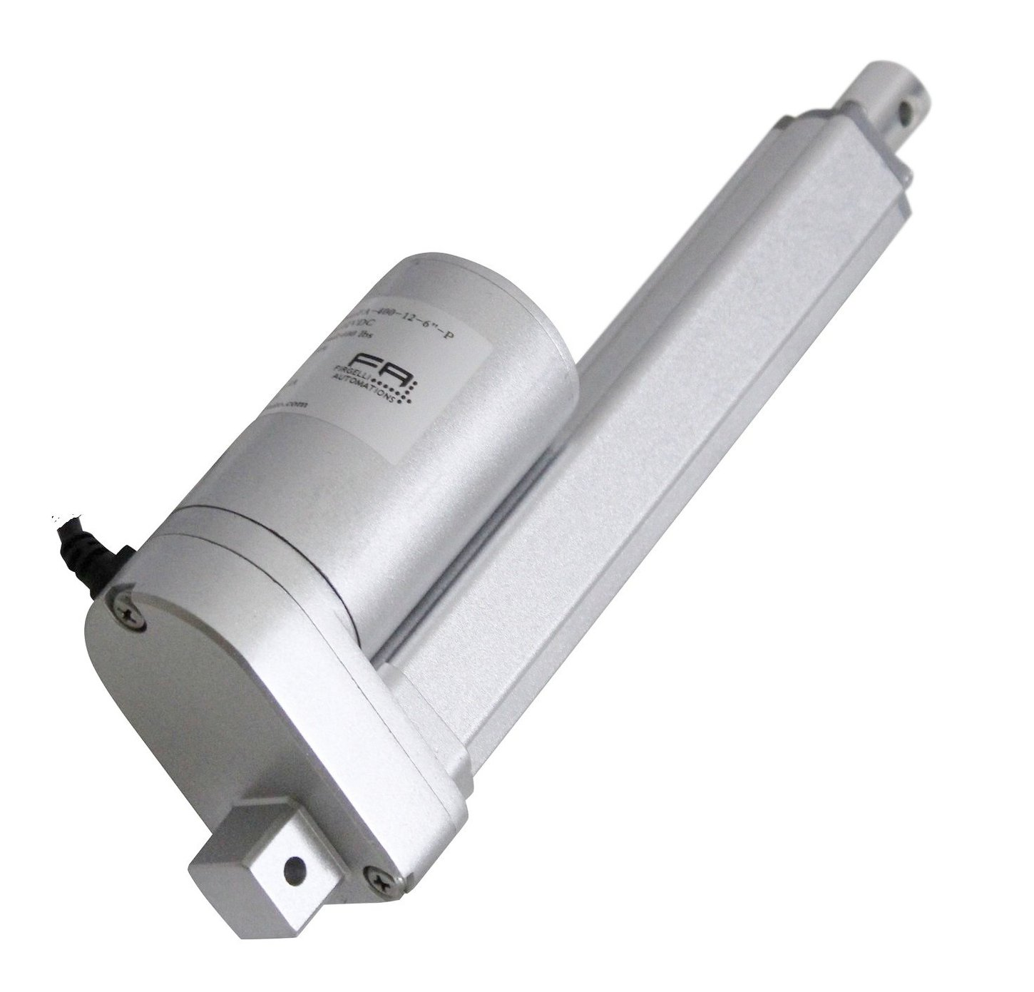
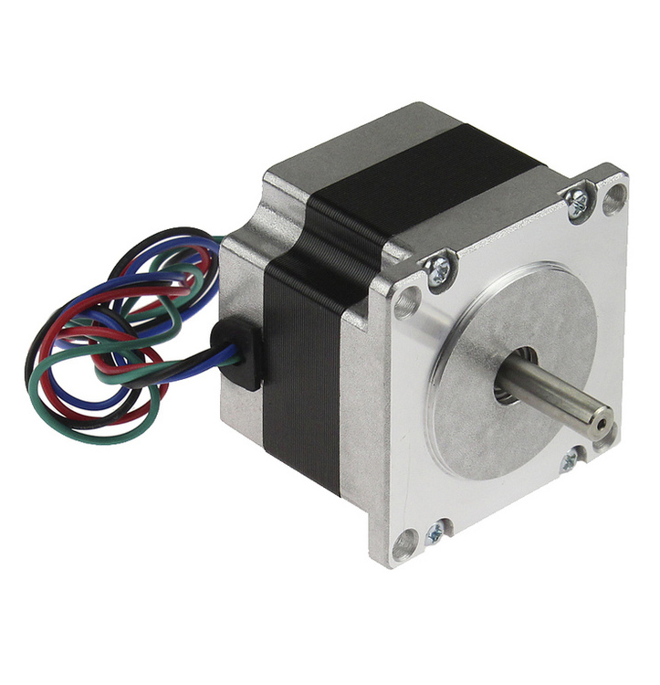
Motor Control
DC & Stepper Motor
Up to ~4 Amps
DRV8872 & DRV825
Auxiliary Battery Support
Protection Schemes

Slide 9
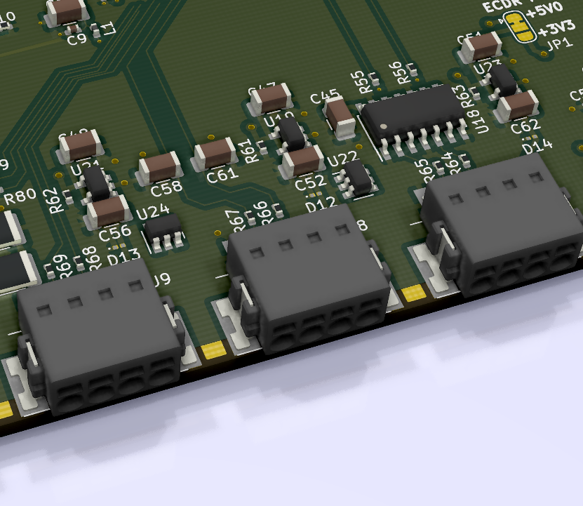
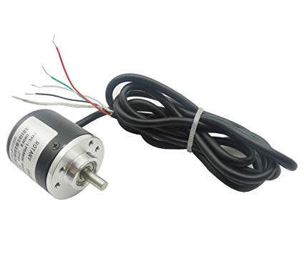
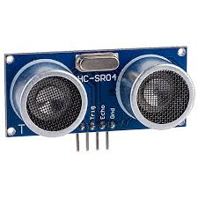
Rotation, Distance, Extension Measurement
All use PIC32 Hardware
Overcurrent/ESD Protection
Linear poten

Slide 10
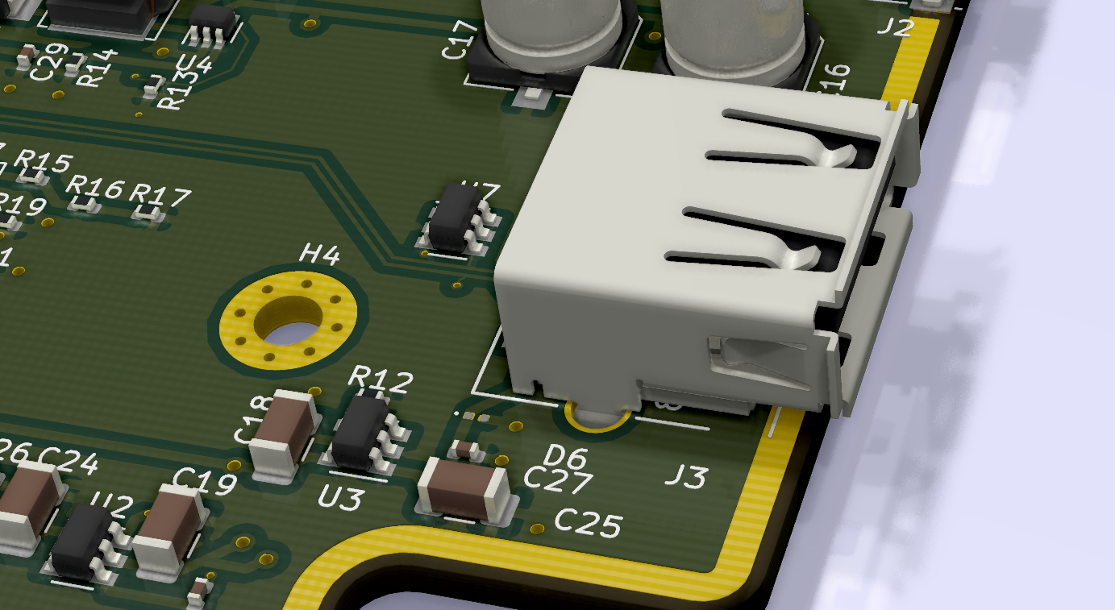
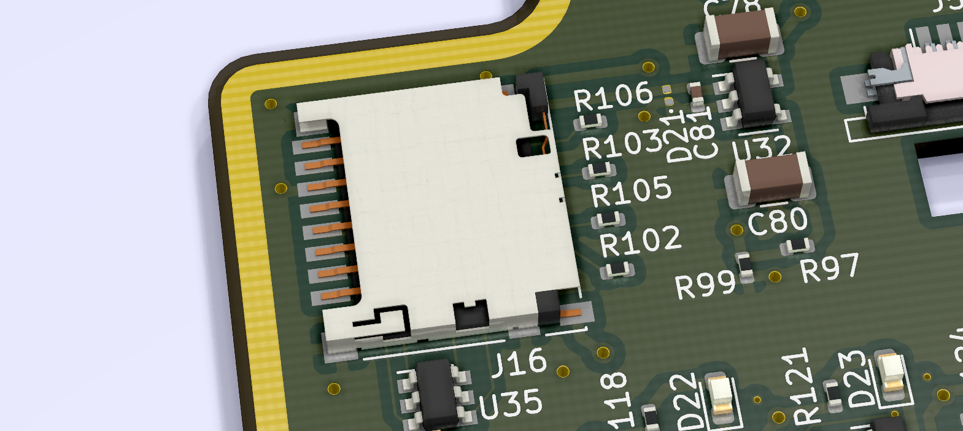
Data Storage
uSD Card Interface
SPI Interface with MCU
USB 2.0 Port
Hot Pluggable
ESD/Overcurrent Protection
USB port also supports bar
code scanner
uSD card, and barcode scanner

Slide 11
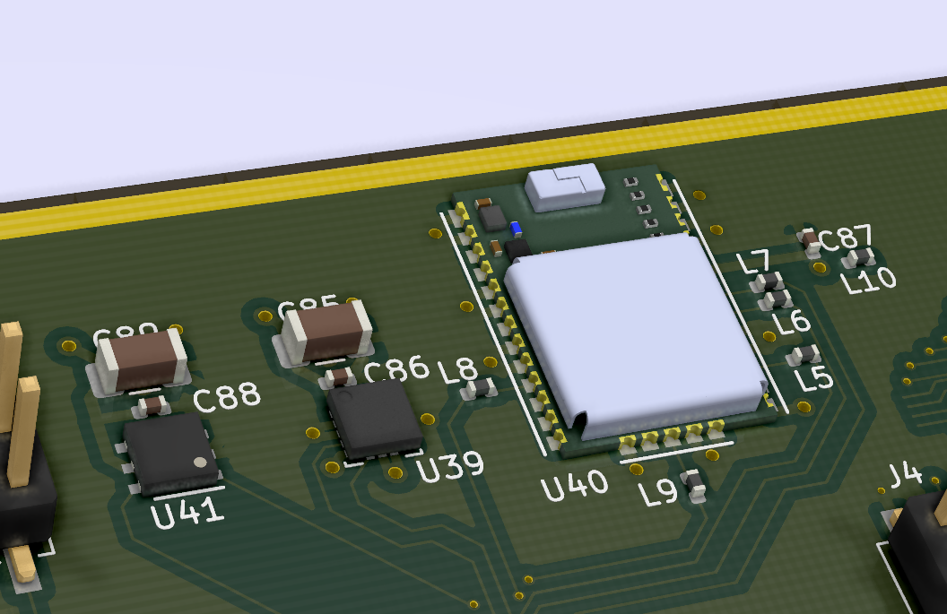
Temp, Humidity, Tilt, Time, Date, & Location
uBlox M8C GNSS Module
ST LIS3D Accelerometer
Silicon Labs Si7006 temp.
and humidity sensor
Infrequent access
One shared I2C Interface
All three chps

Slide 12
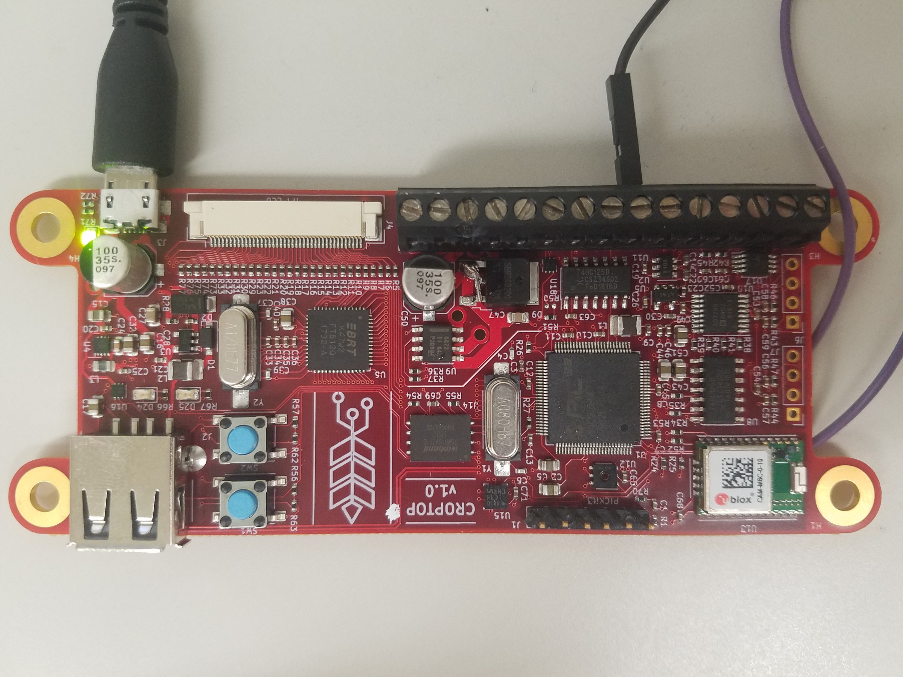
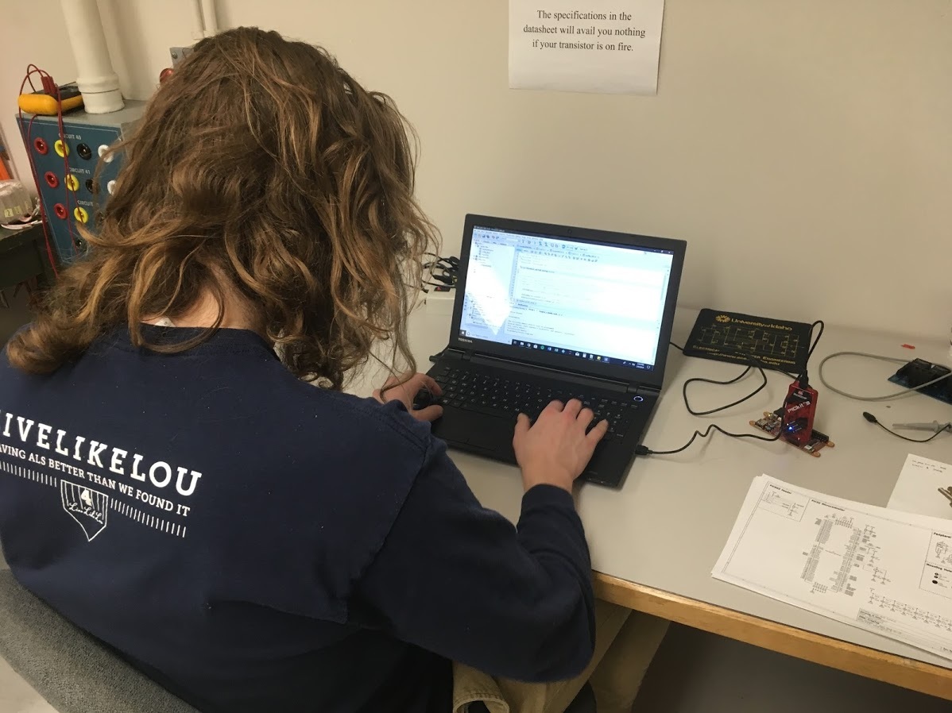
Software Design
Created Custom Development Board
In-Circuit Programming
Github used for version control
All user code compiled to PIC32
“Bare-metal”
Created software stack

Slide 13
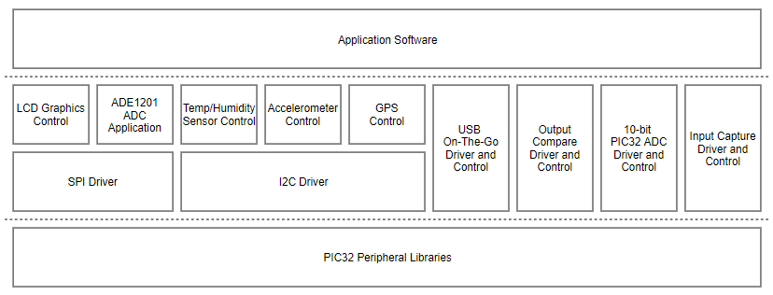
Software Stack
“Bottom-Up”
Development Style

Slide 14

Mechanical Design
Mounts to TFT LCD
3mm screws/standoffs
Board edge connectors
Accessible thru holes in case

Slide 15

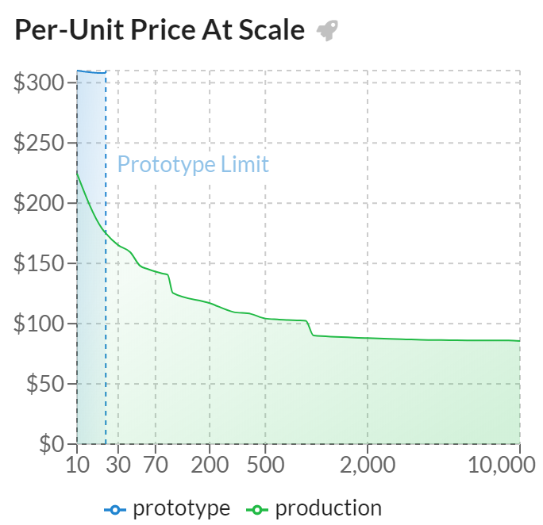
Manufacturing Plan
Contract Manufacturer
PCB and Assembly
Based out of Austin, TX
3 Week Lead Times
Low Per-Unit Cost

Slide 16
Design Outcomes
A single printed circuit board
$150 per board
Zero assembly time
Improved user interface
Improved reliability
Smaller form factor
High performance
Straightforward codebase

Slide 17
Question(s)

Slide 18
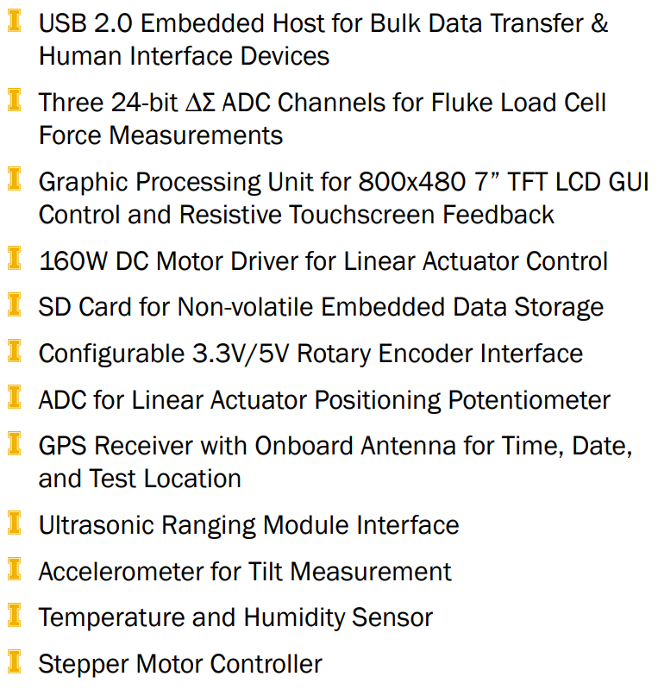
CropTop v2.0

Slide 19
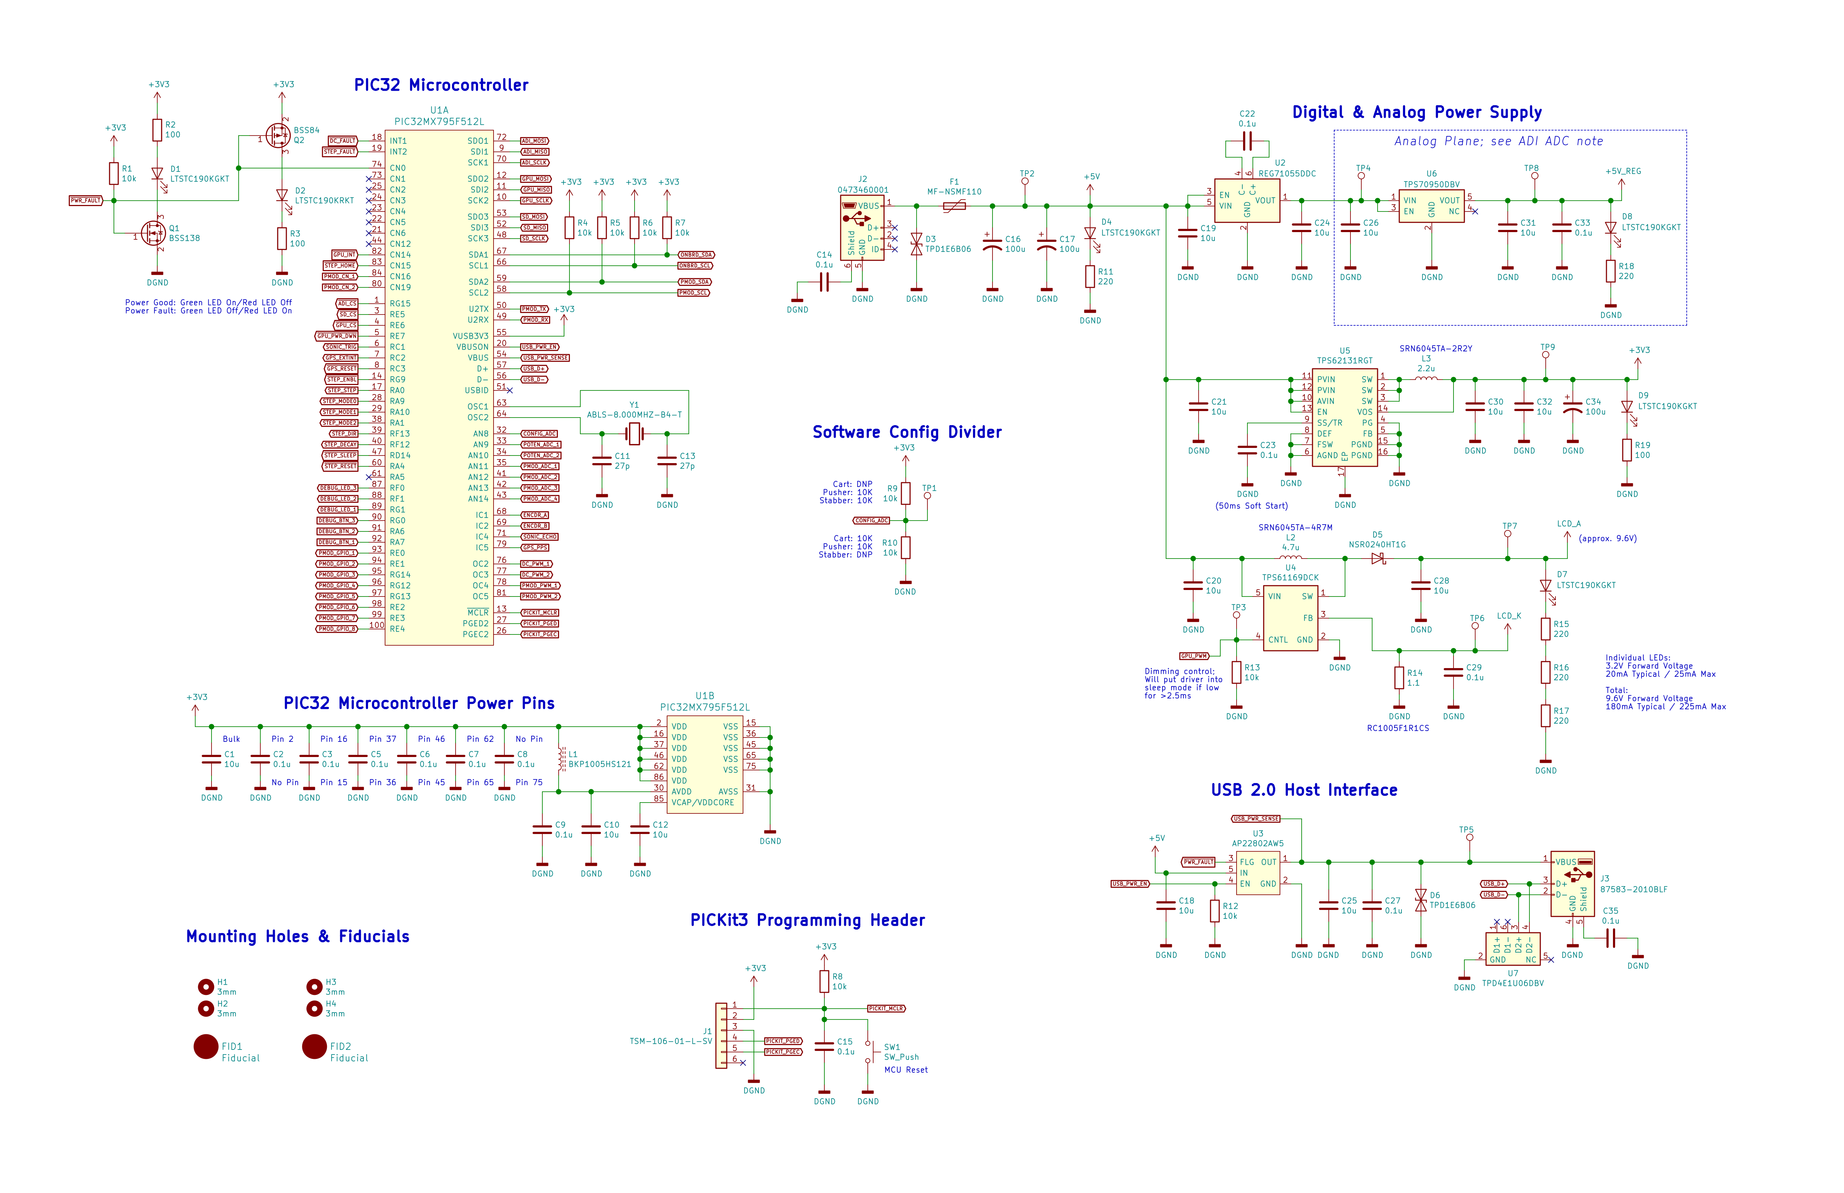

Slide 20
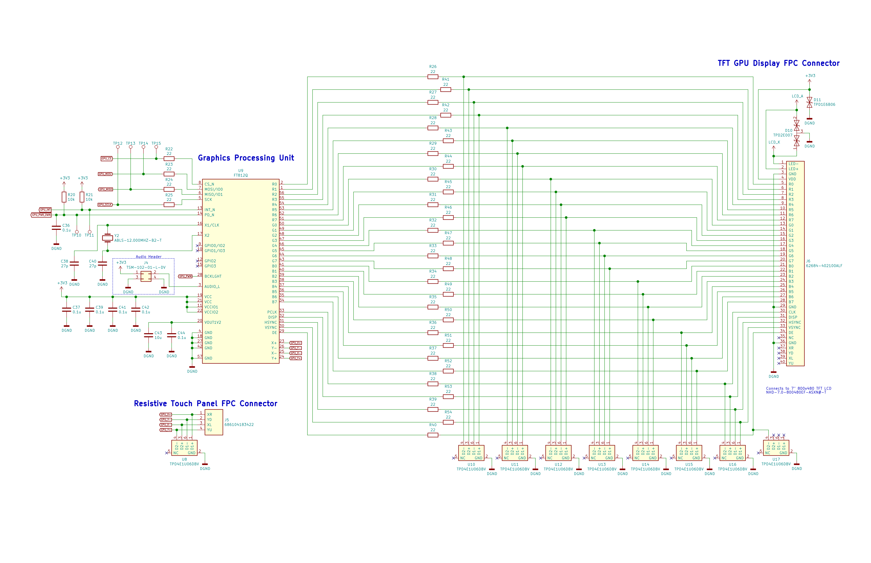

Slide 21
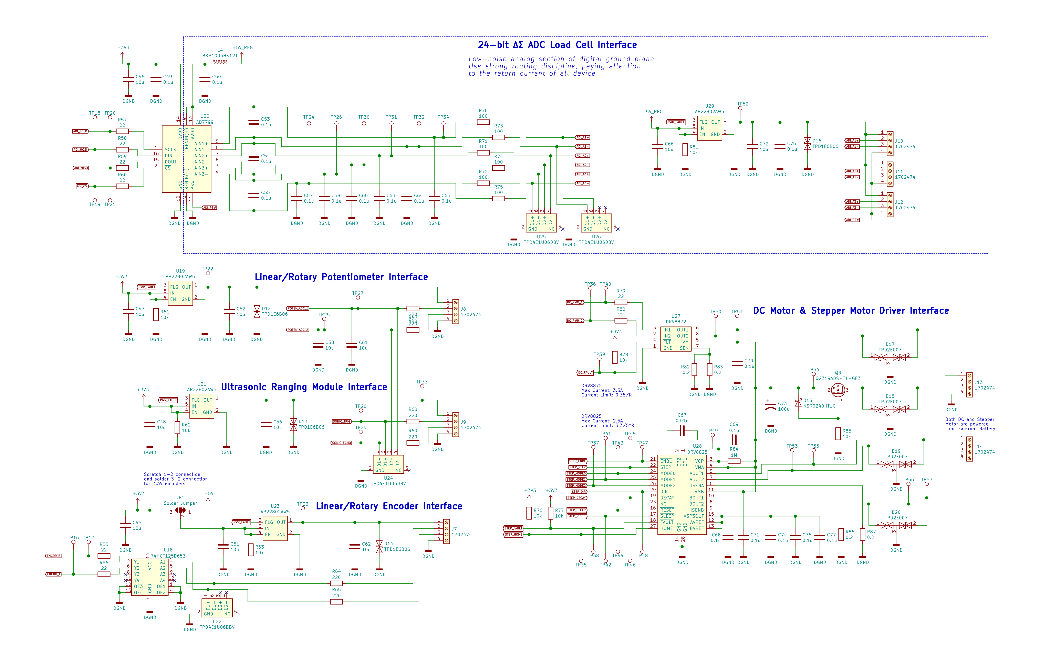

Slide 22
